Slide 1
Health Awareness and Nutrition
Food Labeling
Department of Clinical Nutrition and Dietetics
College of Health Sciences

Slide 2
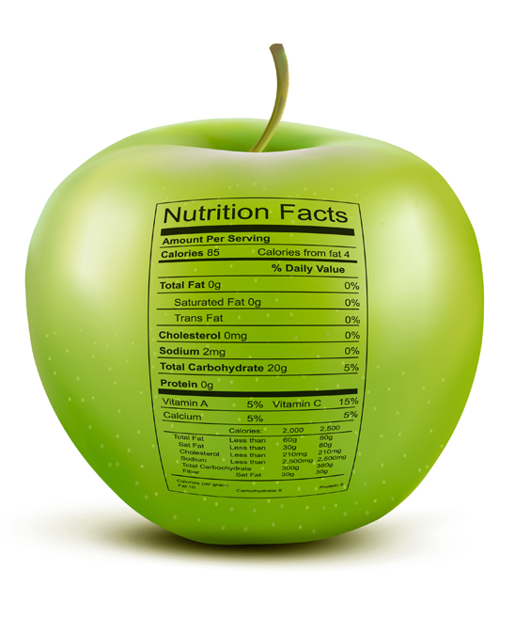
Why Should I Use the Food Label?
They are a source of consumer education.
They are genuine claims about the facts of the product.
The food statements must meet government health/safety definitions.
To check the health claims and effects of diet on health.
To make a comparison between products.
They help consumers know more about the foods they are eating and thus help them to make better choices.
All packaged foods have nutrition labels.
*Exceptions: foods contributing too few nutrients like coffee, tea and spices

Slide 3
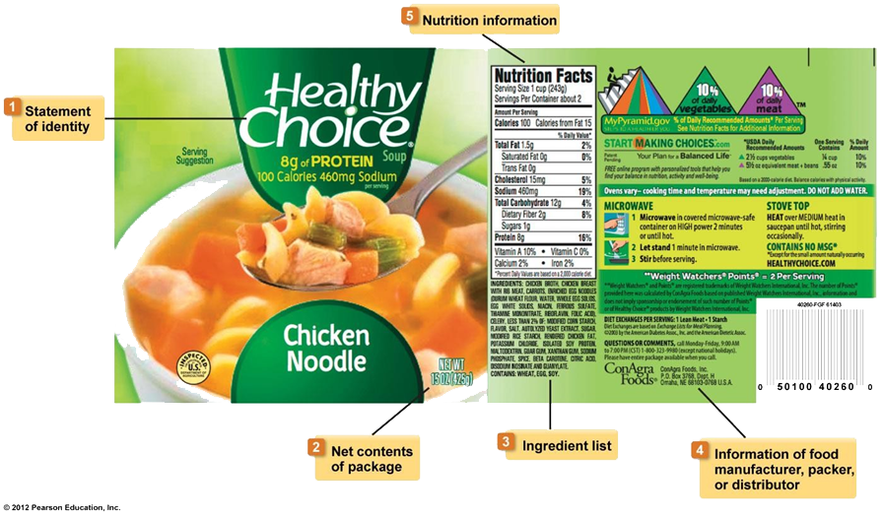
What Information is on Food Labels?

Slide 4
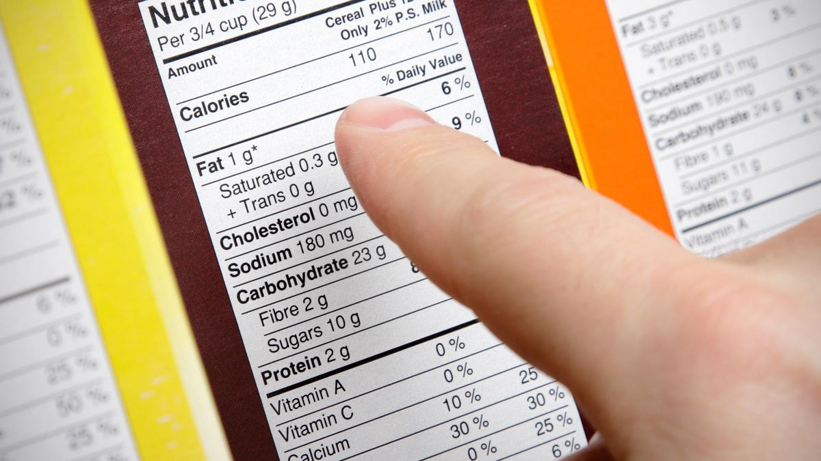
The Importance of Reading Food Labels
You should practice reading food labels as they are a good planning tool for a healthy and balanced diet.
And individuals who suffer from health conditions such as high blood pressure, high levels of harmful cholesterol, diabetes, and other diseases must resort to it.

Slide 5
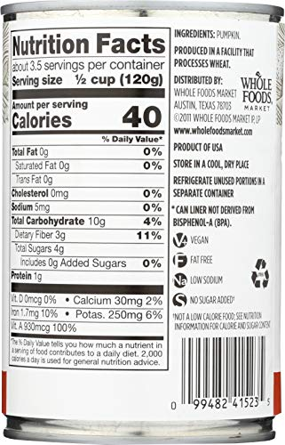
What Type of Information Should the
Food Label Contain?
Mandatory information
Name of the food, company, list of ingredients, production and expiry date, etc.
Nutrition information
Nutrition facts, health claims, etc.
Other information

Slide 6
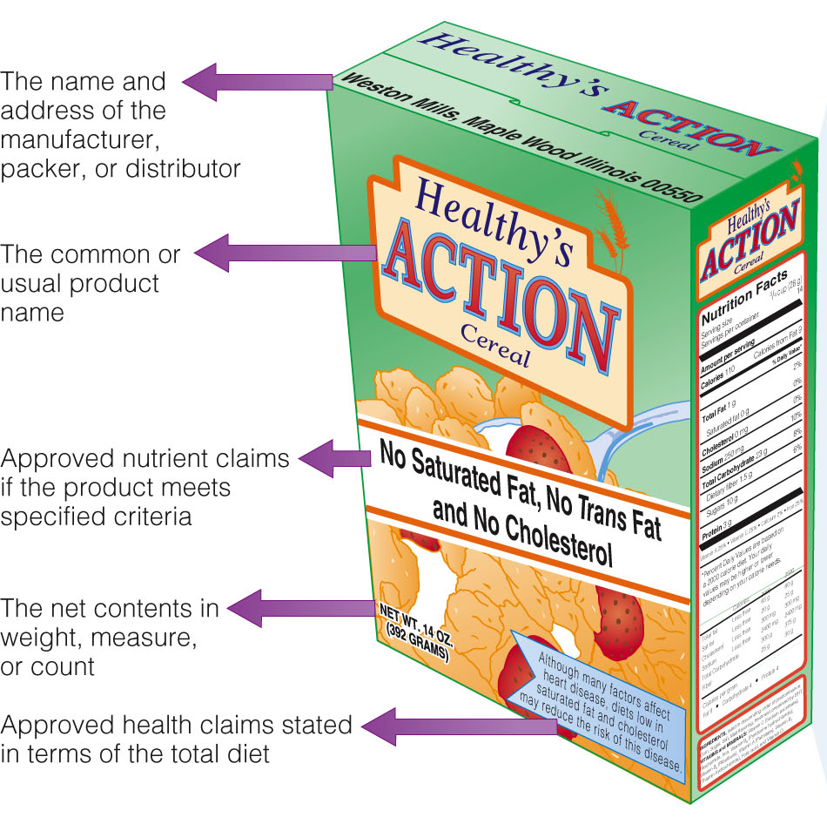
Mandatory Information
The information present on the label should include the:
Name of product
Name and address of manufacturer (company)
Net contents in terms of weight, measure, or count
List of ingredients (in ordinary language) in descending order of predominance by weight
Expiration and manufacturing date

Slide 7
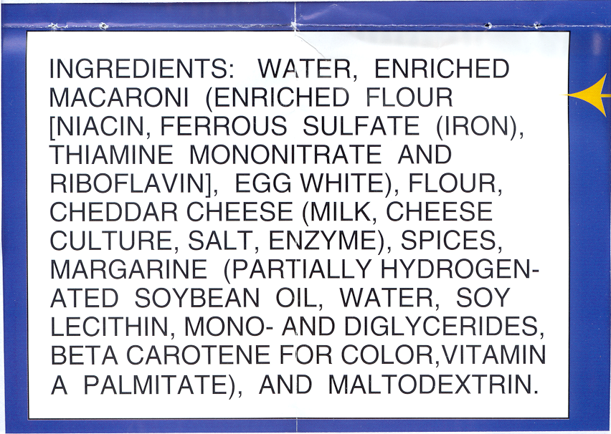
Mandatory Information
To be healthy, the first 3 ingredients should not include the following:
Sugar
Fructose corn syrup
Oil (any kind), Shortening
Salt (sodium)
Artificial ingredients
Preservatives
Sources of some ingredients will be stated by name to help people better identify them.
It is required by law to list any allergens either in the ingredient list or a separate statement with the word “contains.”
CONTAINS WHEAT, MILK, AND EGG INGREDIENTS.

Slide 8
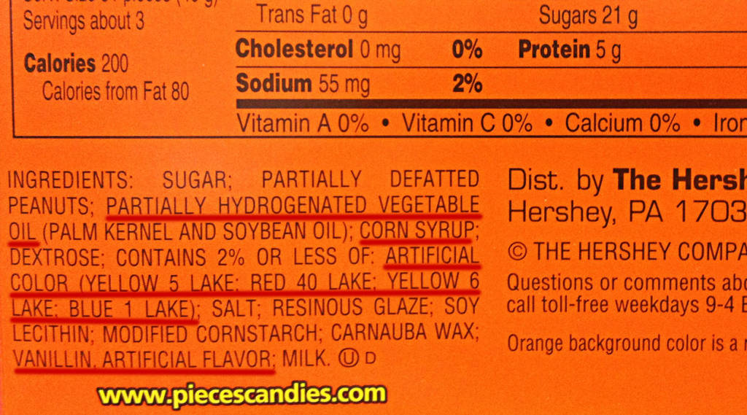
Mandatory Information
Ingredients List:
Name of ingredients that should be mentioned on the label.
The name of the food (item) itself being sold as a food.
The treatment that has been accompanied with food such as (dried).
The words, “flavoring and natural,” should be added with the name of the food.
The words “produced from genetically modified Soya” should be declared in the list of ingredients.

Slide 9
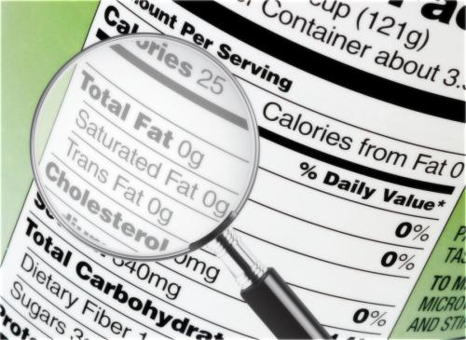
Foods Exempted from
“List of Ingredients”
Unprocessed fruit and vegetables
Carbonated water
Cheese, butter, fermented milk, and fermented cream to which only lactic products, enzymes and microorganism cultures essential to manufacture have been added, or, in the case of cheese
Flour containing only legally required nutritional additives

Slide 10
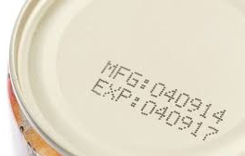
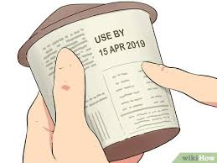
Date Marks
There are two different date marks that appear on food labels:
“Use-by” – found on perishable foods, e.g. milk, red meat, fish. Foods are not safe to eat after this date.
“Best before” – found on a wide range of foods including frozen, dried and canned foods. “Best before” dates are about quality, not safety, and are reliant on the food being stored according to the instructions on the label.

Slide 11
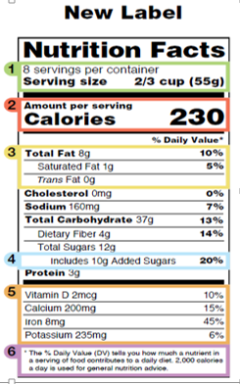
Nutritional Information
Nutrition Facts:
1. Number of servings/container
2. Calories
3. Nutrient amounts and percentages of DVs
Total Fat (saturated and trans)
Cholesterol
Sodium
Total Carbohydrate (fibers and sugars)
Protein
4. Added Sugars (if any)
5. Vitamins and Minerals
Vitamin D, Calcium, Potassium and Iron
6. % Daily Value (DV)

Slide 12
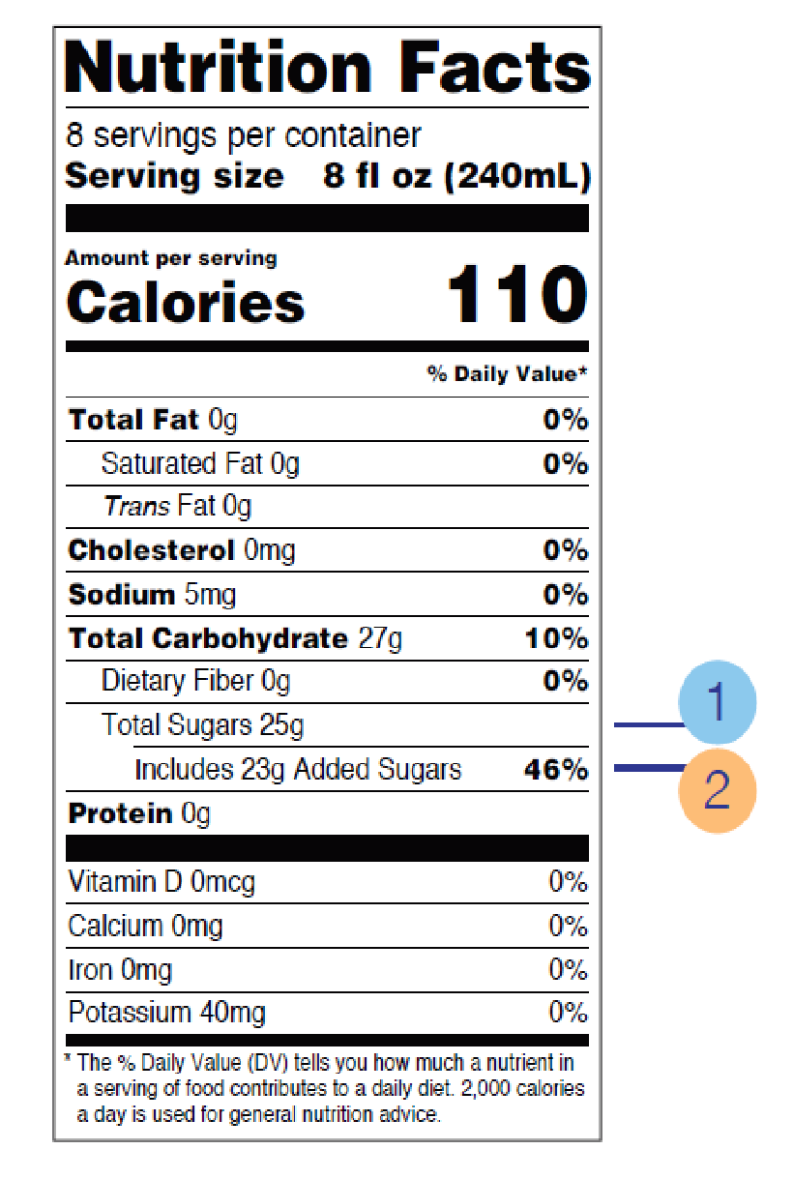
Added Sugars
The Dietary Guidelines for Americans recommends limiting calories from added sugars to less than 10 percent of total calories per day.
For example, if you consume a 2,000 calorie daily diet, that would be 200 calories or 50 grams of added sugars per day.
Having the word “includes” before added sugars on the label indicates that added sugars are included in the number of grams of total sugars in the product.
For example, a container of yogurt with added sweeteners means that one serving of the product has 23 grams of added sugars and 2 grams of naturally occurring sugars represents 46% of the Daily Value for added sugars.

Slide 13
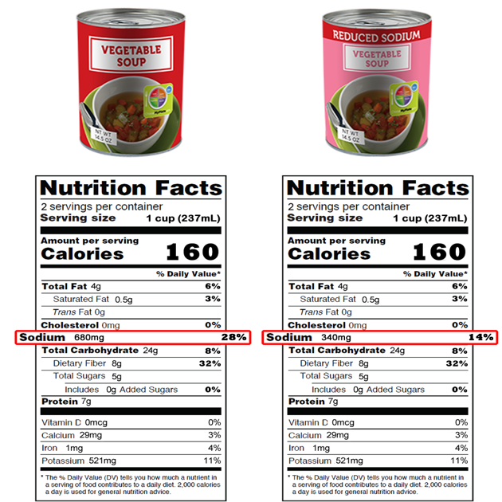
Smart Label Reading
Take a look at the two soup labels.
First, think about how much soup you would usually consume. There are two servings per can, but would you eat the entire can or just half of it?
Many people would eat the whole can, and if that’s you, you would want to double all of the calorie and nutrient information.
Both soups provide 160 calories per one-cup serving, or 320 calories for the entire can.
Notes:
‹#›

Slide 14
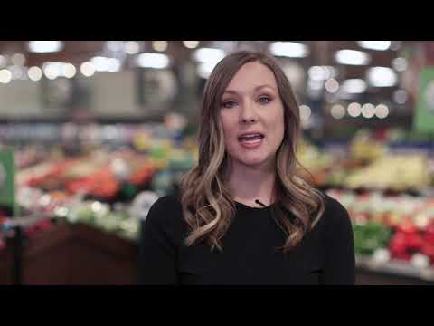
Smart Label Reading
Notes:
https://www.youtube.com/watch?v=tB7BgszxLs8&t=47s

Slide 15
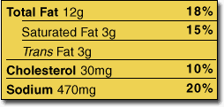
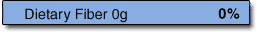
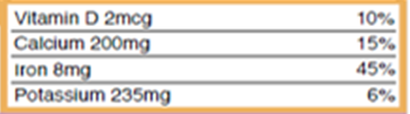
Nutritional Information (Nutrition Facts)
Limit these nutrients:
Keep the intake of saturated fat, trans fat and cholesterol as low as possible in a nutritionally balanced diet.
Increase these nutrients:
Eat more fiber, vitamins and minerals.

Slide 16
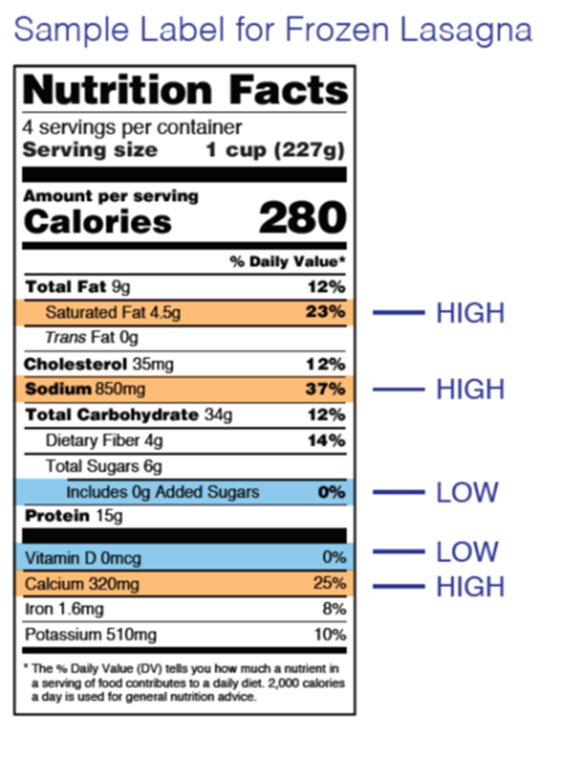
Nutritional Information (Nutrition Facts)
What are the % daily values?
Found on food labels
Apply to the “average” person eating 2,000 calories a day
% Daily Value puts nutrients on a scale from 0% to 100%.
This scale tells you if there is a little or a lot of a nutrient in one serving of a packaged food.
If < 5% this food is low in _____________.
If > 20% this food is high in _____________.

Slide 17
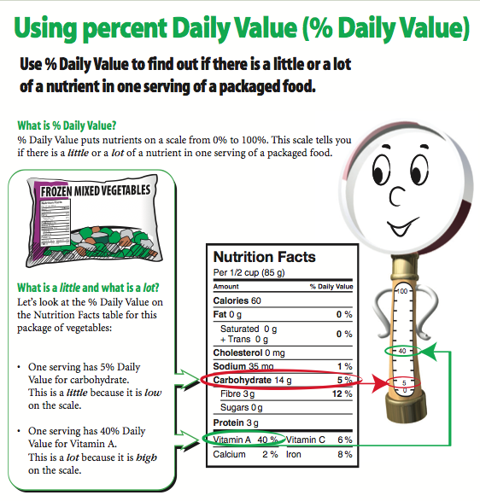

Slide 18
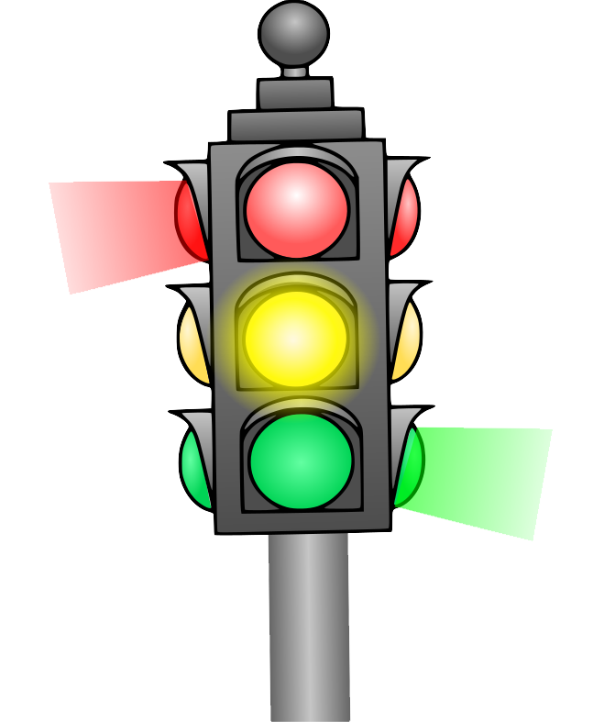
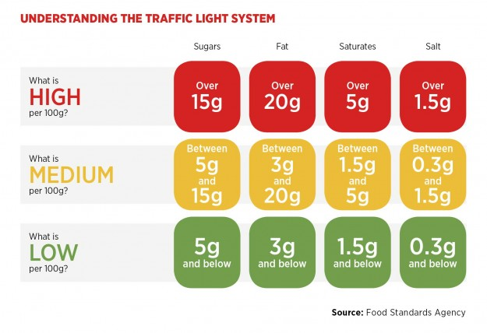
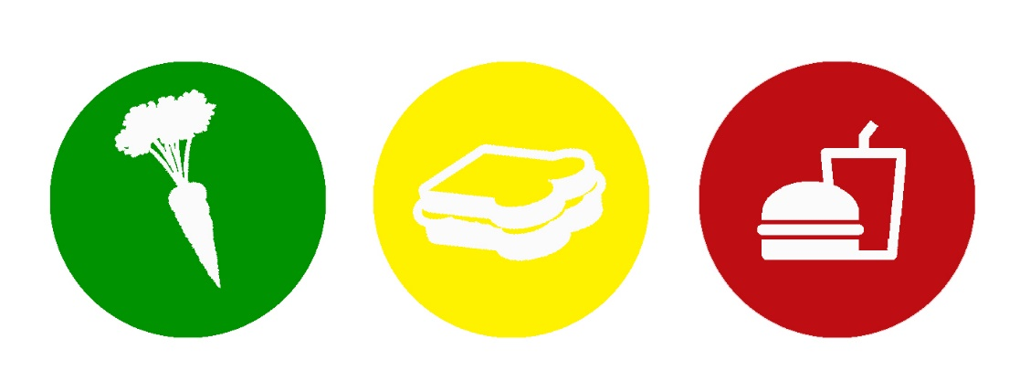
Traffic Light Labels

Slide 19

Traffic Light Labels in the UAE
The UAE’s labeling system will require the contents of fat, saturated fats, sugars and salts in the pre-packaged food to be shown by using traffic lights.
The traffic light system is to be printed on the front side of the packaging making it easier for consumers to see which nutrients are low and high in the food.
ABU DHABI, 11th December 2021 - the UAE Cabinet has amended the requirement for nutritional labeling (Nutritional labeling of prepackaged products as traffic light colors) from mandatory to voluntary.
Under the standard, which was scheduled to become mandatory in early January 2022, manufacturers were required to provide a color-coded system of nutritional data in all pre-packed food products.

Slide 20
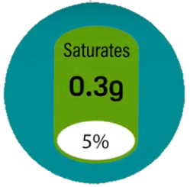
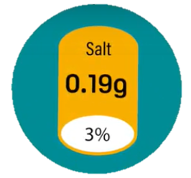
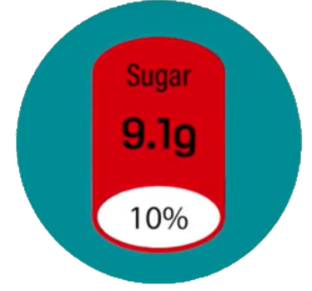
Tips About Traffic Light Colors
It is a label that can be placed on pre-packaged food and drinks to show nutritional information with details on fat, saturated fat, sugars and salt content. The information can be for either 100g or 100mL of the food or drink or per portion size. The percentages on the traffic light labels are called “percentage reference intakes.” They indicate how the amount of fat, saturates, sugars and salt fit into your daily recommended diet.
Green means the food is low in the nutrient. The more green light a label displays, the healthier the food choice is
Amber means the food is neither high or low in the nutrient. It is an okay choice most of the time
Red means the food contains high amounts of the nutrient and you should try to eat it less often or in smaller amounts
Notes:
https://www.nhs.uk/live-well/eat-well/how-to-read-food-labels/
http://www.fao.org/3/i0576e/i0576e04.pdf
http://connector.ae/health-and-fitness/6001/uaes-nutrition-labelling-policy#:~:text=What%20Is%20Traffic%20Light%20Labelling,drink%20or%20per%20portion%20size

Slide 21
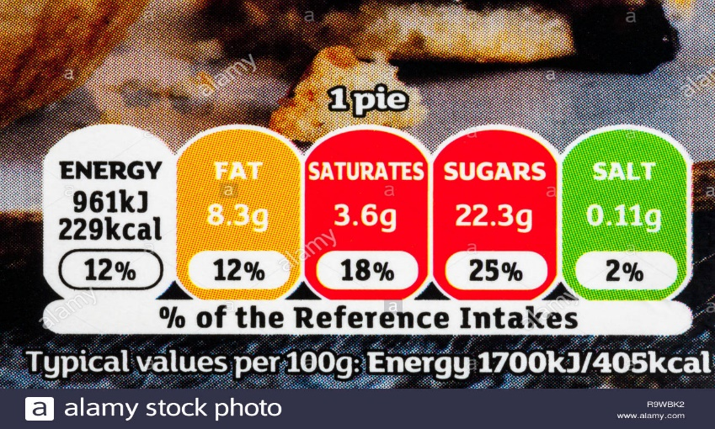
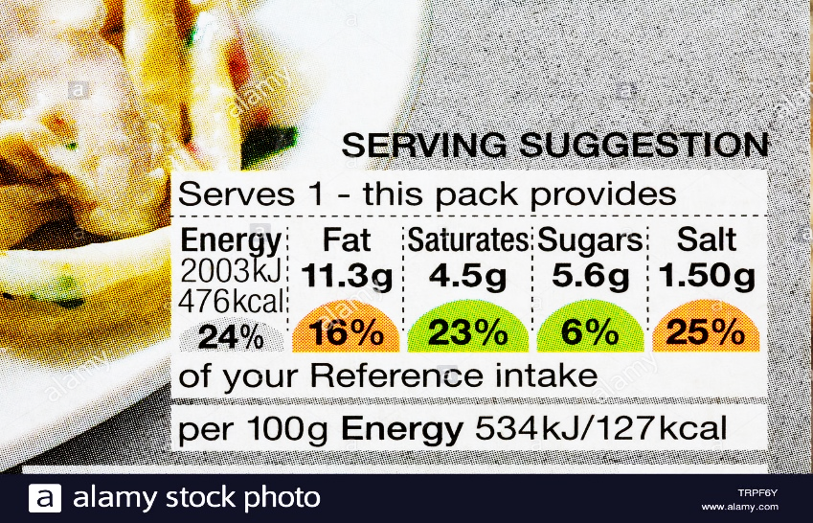
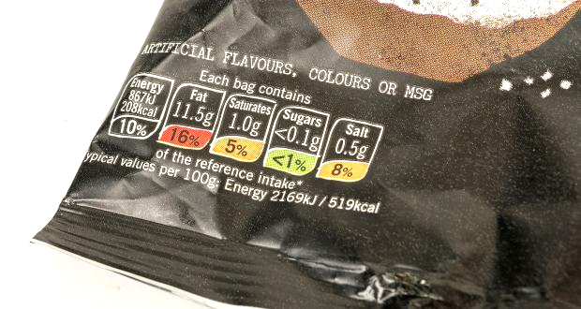
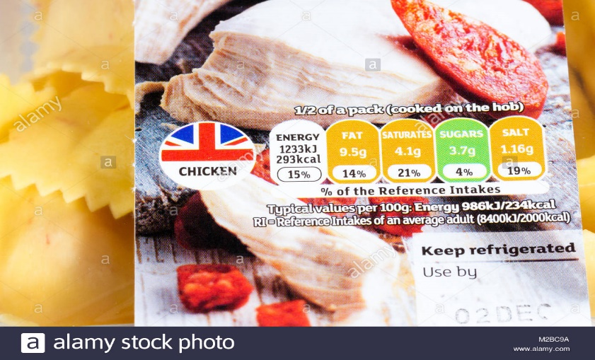
Traffic Light Labels

Slide 22
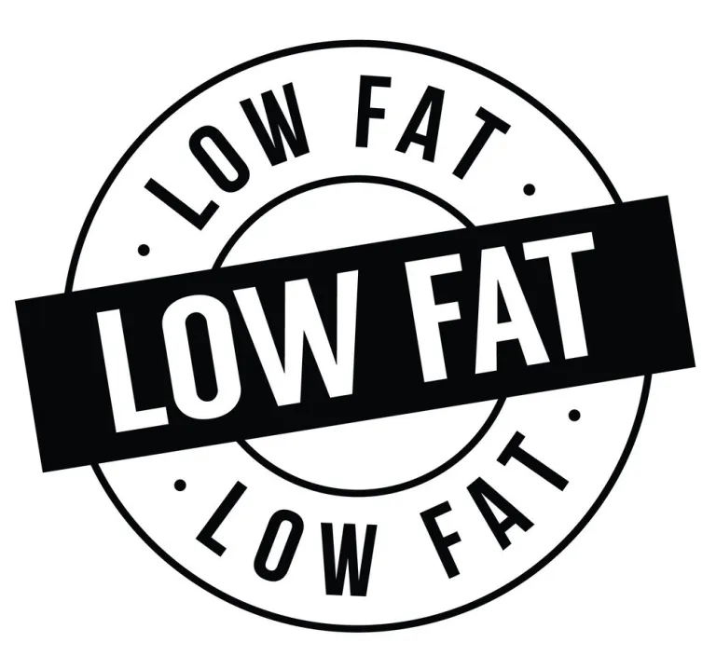
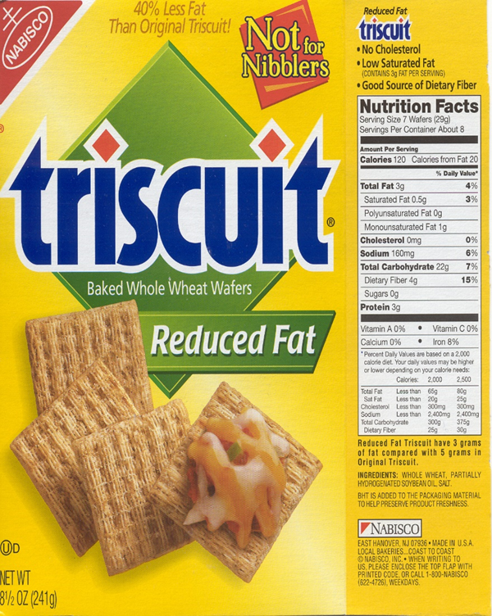
Nutrition Information
Nutrition Content Claims: Used to describe the level of a nutrient in a food
Claim
Fat-Free
Low Fat
Less Fat
Saturated Fat Free
Reduced Calorie
Requirements that must be met before using the claim in food labeling
Less than 0.5 grams of fat per serving, with no added fat or oil
3 grams or less of fat per serving
25% or less fat than the comparison food
Less than 0.5 grams of saturated fat and trans-fatty acids per serving
25% or fewer calories per serving than the comparison food

Slide 23
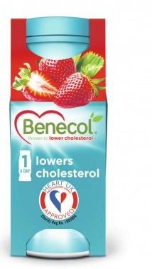
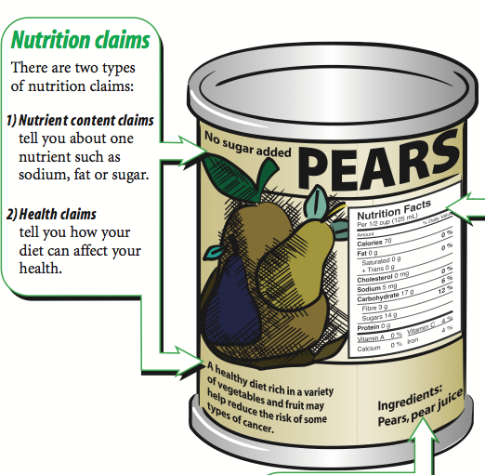
Health Claims
It means the relationship between nutrients, daily diet and a specific disease, such as the relationship between:
Fat and cancer
Cholesterol and coronary heart disease
Sodium and hypertension

Slide 24
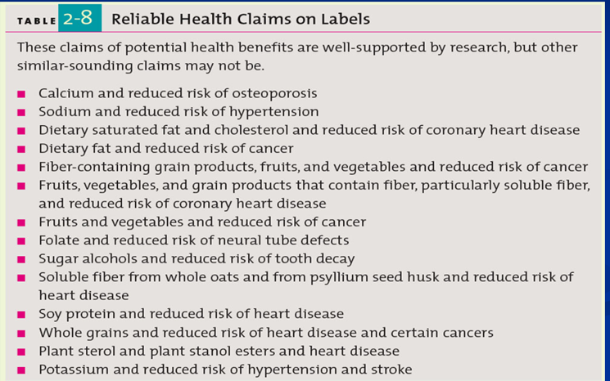
Reliable Health Claims

Slide 25
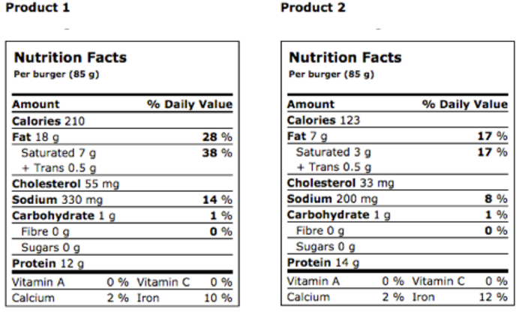
Product Label Comparison
Sometimes it is not as clear which food is the healthier choice.
For example, one product might be low in fat but high in salt while another one may be high in fat but low in salt.
The one you choose will depend on your specific needs and requirements.
Notes:
‹#›

Slide 26
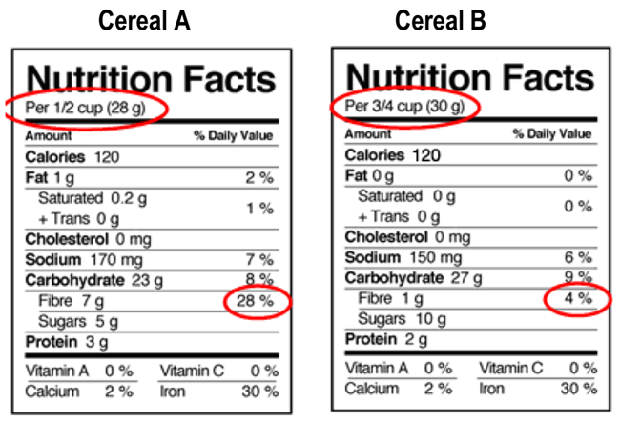
Product Label Comparison

Slide 27
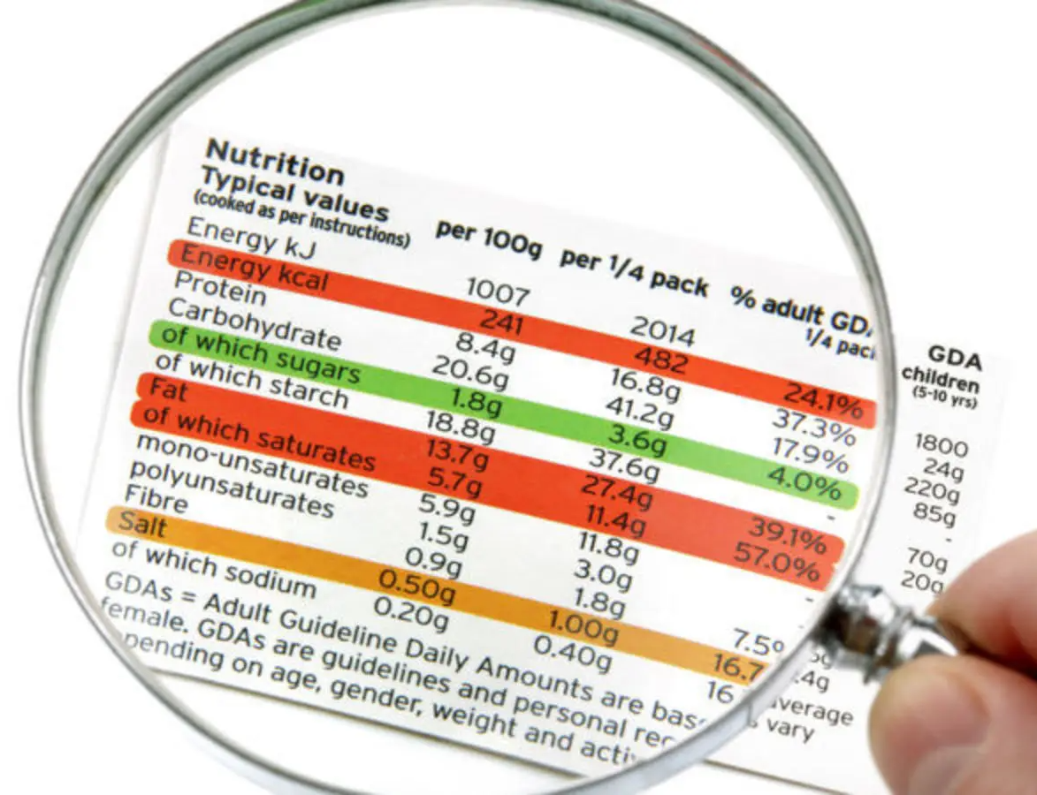
Food Label in UAE
Food label in UAE regulations must contain the following information:
Product and brand name
Ingredients in descending order of proportion
Additives using their “E” number
The origin of all animal fats (should be of Halal origin)
Net content in metric units
Production and expiry dates
Country of origin
Manufacturer’s/exporter’s name and address
Special storage and preparation instructions, if any

Slide 28
E Numbers
E numbers are number codes for food additives that have been assessed for use within the
European Union (the "E" prefix stands for "Europe").
Classification by numeric range:
E100–E199 (colours)
E200–E299 (preservatives)
E300–E399 (antioxidants, acidity regulators)
E400–E499 (thickeners, stabilizers, emulsifiers)
E500–E599 (acidity regulators, anti-caking agents)
E600–E699 (flavour enhancers)
E700–E799 (antibiotics)
E900–E999 (miscellaneous)
E1000–E1599 (additional chemicals)
Notes:
‹#›

Slide 29

Information For
Your Interest

Slide 30
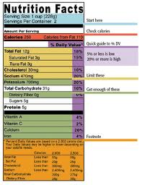
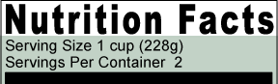
Serving Size
Serving sizes are standardized to make it easier to compare similar foods.
They are provided in familiar units, such as cups or pieces, followed by the metric amount, e.g., the number of grams.
The size of the serving on the food package influences the number of calories and all the nutrient amounts listed on the top part of the label.
Pay attention to the serving size, especially how many servings there are in the food package.
In the sample label, one serving of macaroni and cheese equals one cup. If a person eats the whole package, he/she would eat two cups. That doubles the calories and other nutrient numbers, including the % Daily Values as shown in the sample label.

Slide 31
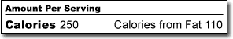
Calories (Calories from Fat)
Calories provide a measure of how much energy you get from a serving of this food. The calorie section of the label can help in managing weight of a person (i.e. gain, lose, or maintain.)
Remember: The number of servings (portion amount) you consume determines the number of calories you actually eat.
General Guide to Calories per serving:
40 Calories is low
100 Calories is moderate
400 Calories or more is high

Slide 32
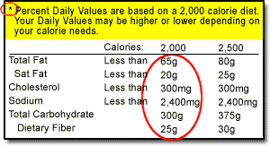
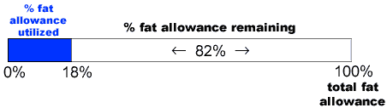
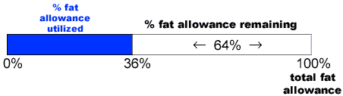
Understanding the Footnote on the
Bottom of the Nutrition Facts Label
1 Serving
2 Servings
% DV of fat (Daily Value)
Note: Trans fat, Sugars and Protein are not listed as a % DV on the Nutrition Facts label.

Slide 33
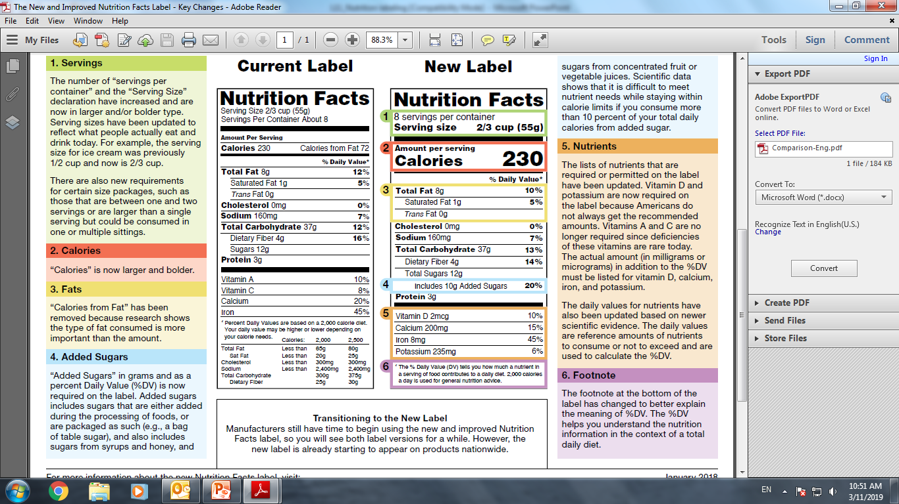
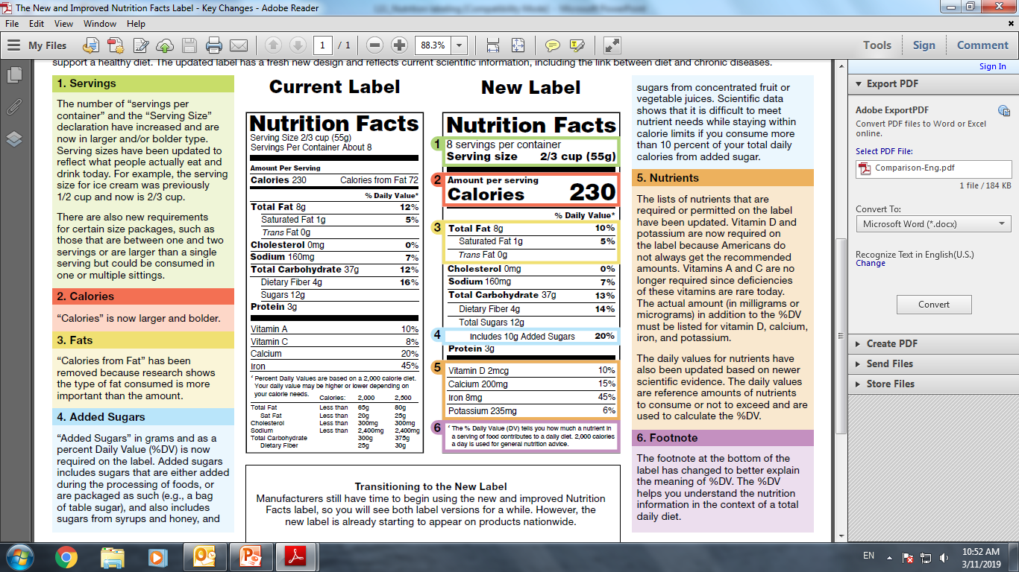
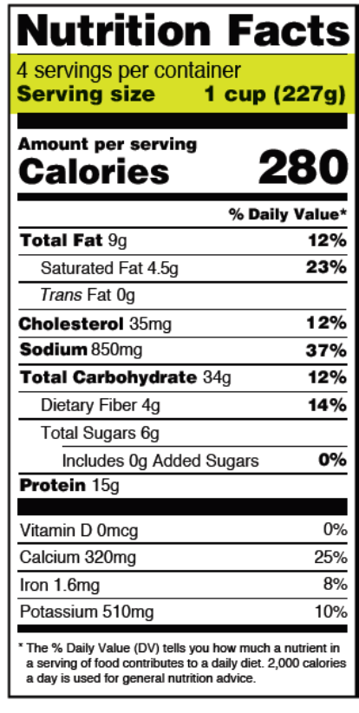
The New and Improved
Nutrition Facts Label – Key Changes

Slide 34
Additional Health Claims
No preservatives:
Contains no preservatives (natural/chemical)
No preservatives added:
No chemical preservative added, but may contains natural preservatives.
High fiber:
5g or more per serving (Foods making high-fiber claims must meet the definition for low fat, or the level of total fat must appear next to the high-fiber claim)

